Slide 1



LOOKER TRAINING FOR BEGINNERS
By Devarajan Palaniappan (DATA POLE)
Session 3

Slide 2
Pivot Concept Unpivot Concept Custom Dimension Custom Measure Basic Filters Advanced Match Filters Custom Filters Group Filters Types of Folders Boards SQL Runner Basic Views of Explore UI
Table of Contents

Slide 3
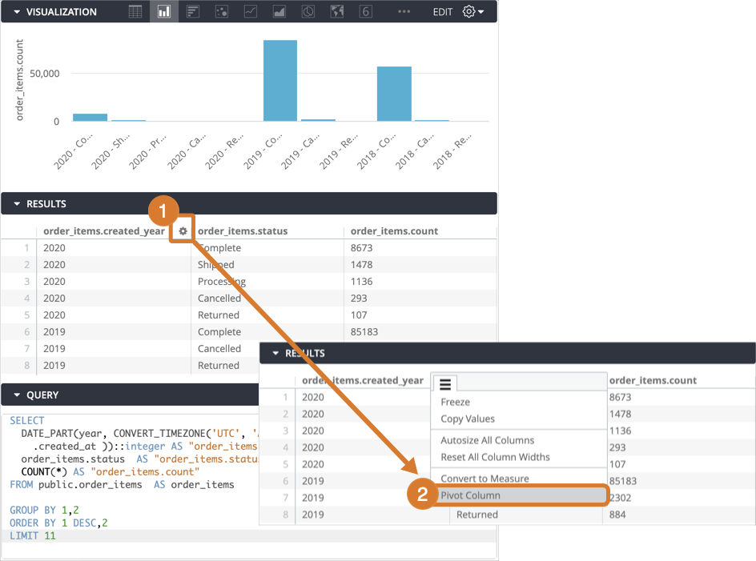

Pivot concept in Looker
Pivot Concept is used to transform data sets into rows to columns.

Slide 4
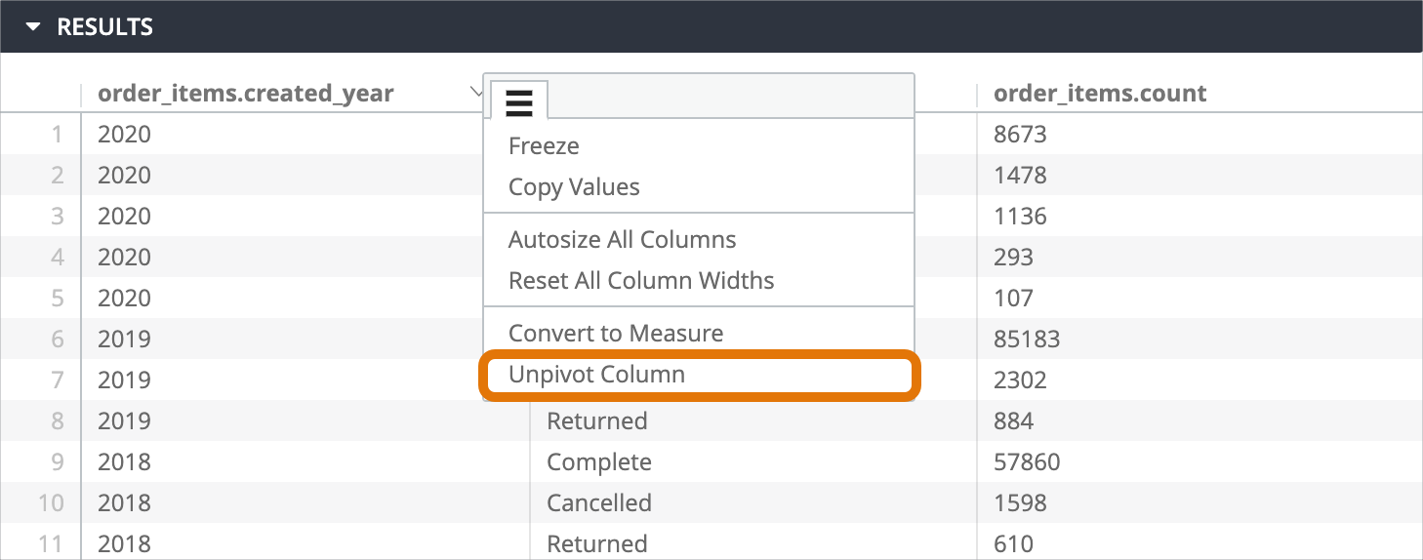

Unpivot Concept in Looker
Unpivot Concept is used to transform data sets into columns to rows.

Slide 5
Custom Dimension
Creating a custom dimension using a Looker expression
To create a custom dimension using a Looker expression and one or more other dimensions, follow these steps:
Select Add in the Custom Fields section of the field picker.
Choose Custom Dimension.
In the Expression box, enter a Looker expression that calculates the value for your dimension, using any Looker functions and operators. The Looker expression editor will suggest field names and display syntax help for any functions you use. Fields that are currently used in an Explore and that are eligible to be used with the field that you're creating are marked with a black circle.
Select a formatting option other than the default in the Format drop-down as desired.
Specify the custom dimension's name in the Name field. The name appears in the field picker and in the data table.
Select + Add Description to add an optional description of up to 255 characters in the Description box to give other users more context or information about the custom dimension.
Select Save.
The field picker will display your new custom dimension in the Custom Fields section.
As with other fields, you can select a custom dimension's name to add or remove it from a query. You can also hover over the field to reveal more options that are available for that field, including selecting its Filter icon to use it as a filter in a query. You can also edit the field as necessary.
Editing a custom dimension
To edit a custom dimension, follow these steps:
In the field picker, expand the Custom Fields section.
Select the three-dot More menu for the custom field that you want to edit.
Select Edit.
Alternatively, select Edit from the custom field's data table gear menu.
Change the custom dimension definition as necessary in the Expression box.
Select a new format from the Format drop-down if desired.
Enter a new name in the Name field as desired. The name appears in the field picker and in the data table. If you have changed a custom field's definition, consider modifying the name to match.
Select + Add Description to add an optional description of up to 255 characters in the Description box to give other users more context or information about the custom dimension.
If there is an existing description, the Description box will automatically appear.
Select Save.

Slide 6
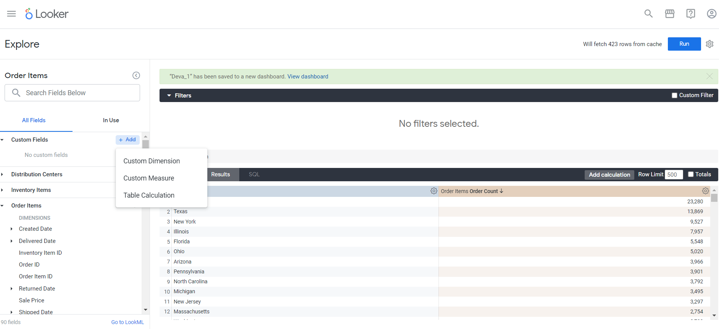


Slide 7
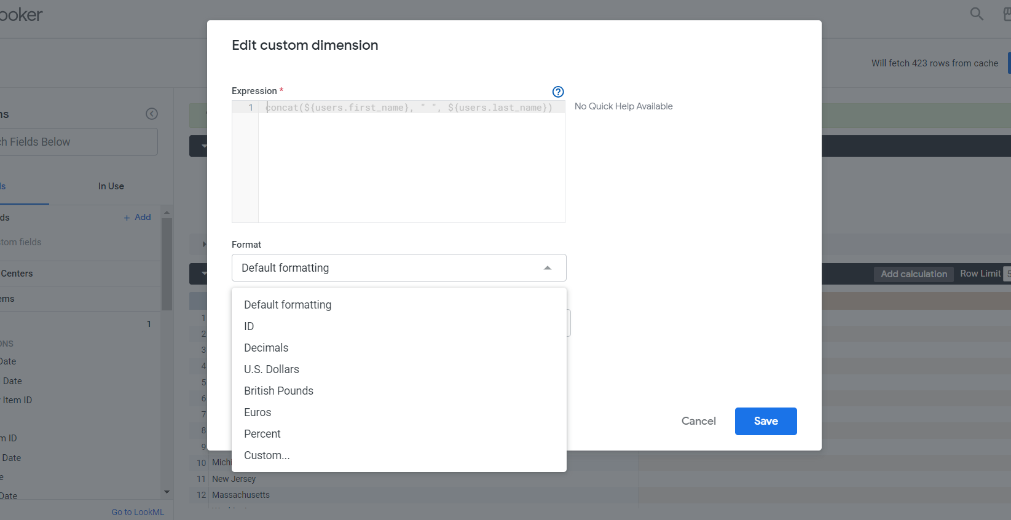


Slide 8
Custom Measure
Creating a custom measure from a dimension
You can create a custom measure from a dimension in one of the following ways:
Using the dimension's three-dot More menu
Using the Custom Fields section of the field picker.
The second method lets you customize the custom field as you create it, such as renaming, adding an optional description, or selecting a different format other than the default.
Using the dimension's three-dot More menu
In many cases, you can use this shortcut technique:
Expand the field picker view that contains the dimension that you want to measure.
Select the dimension's three-dot More menu.
Select Aggregate to display options for creating a custom measure. The suggested functions vary based on the type of dimension you've chosen (such as number, string, or date). Select a function.
Expand the Custom Fields section in the field picker to see your new field.
As with other fields, you can select a custom field's name to add or remove it from a query. You can also hover over the field to reveal more options that are available for that field, including selecting its Filter icon to use it as a filter in a query. You can also edit the field as necessary.
Custom field types for measures
You can create only one custom field type, a filtered measure, from measures in an Explore's field picker, depending on the base LookML measure type.
The following table outlines the LookML fields to which measure types you can add a filter.
string measure type
list measure type
date measure type
yesno measure type
numeric measure types*

Slide 9


Slide 10
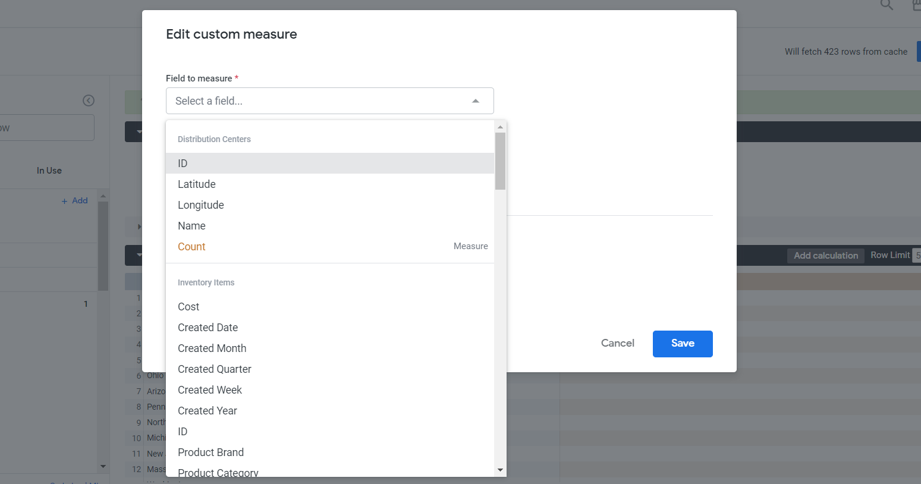


Slide 11
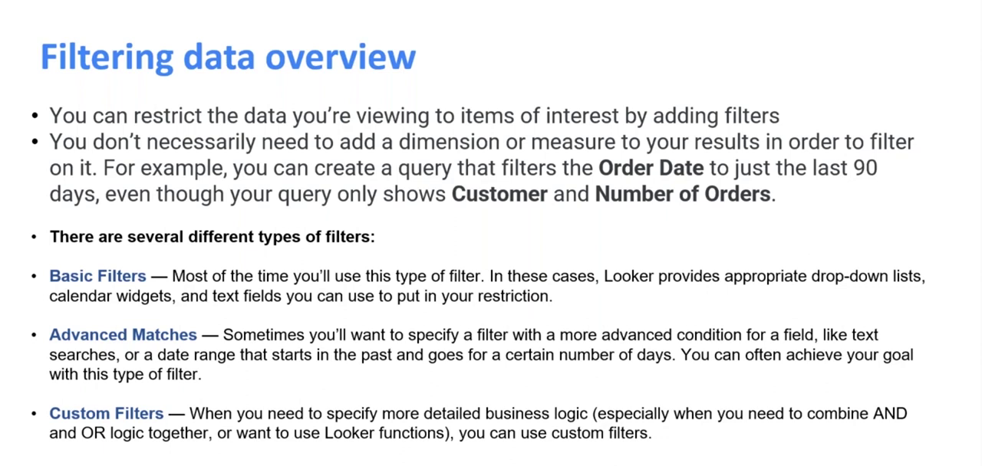

Slide 12
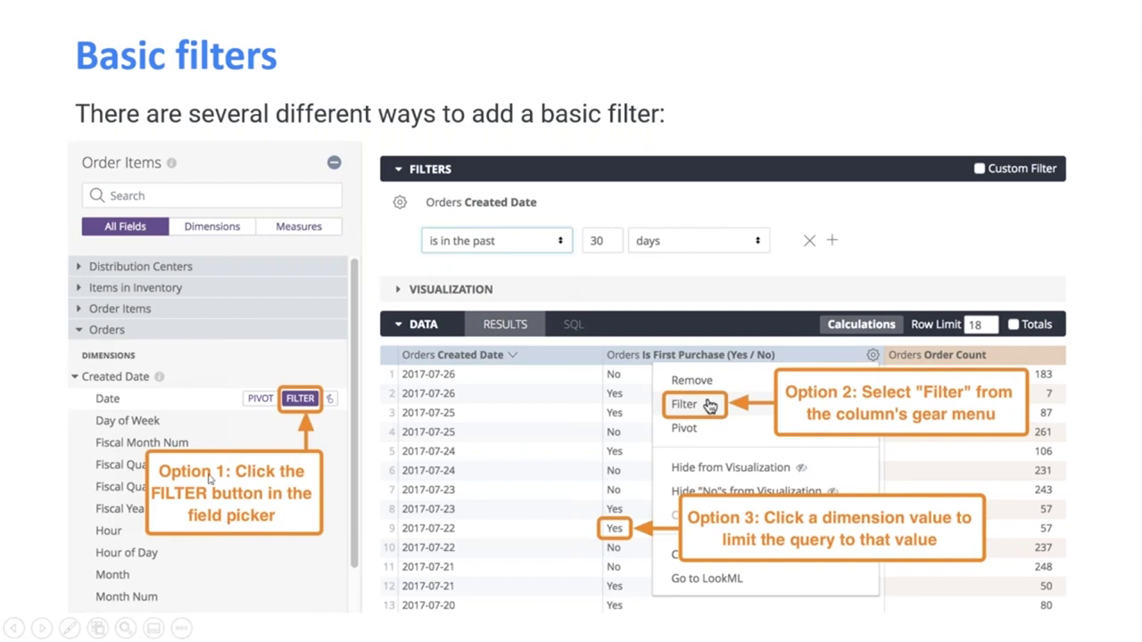

Slide 13
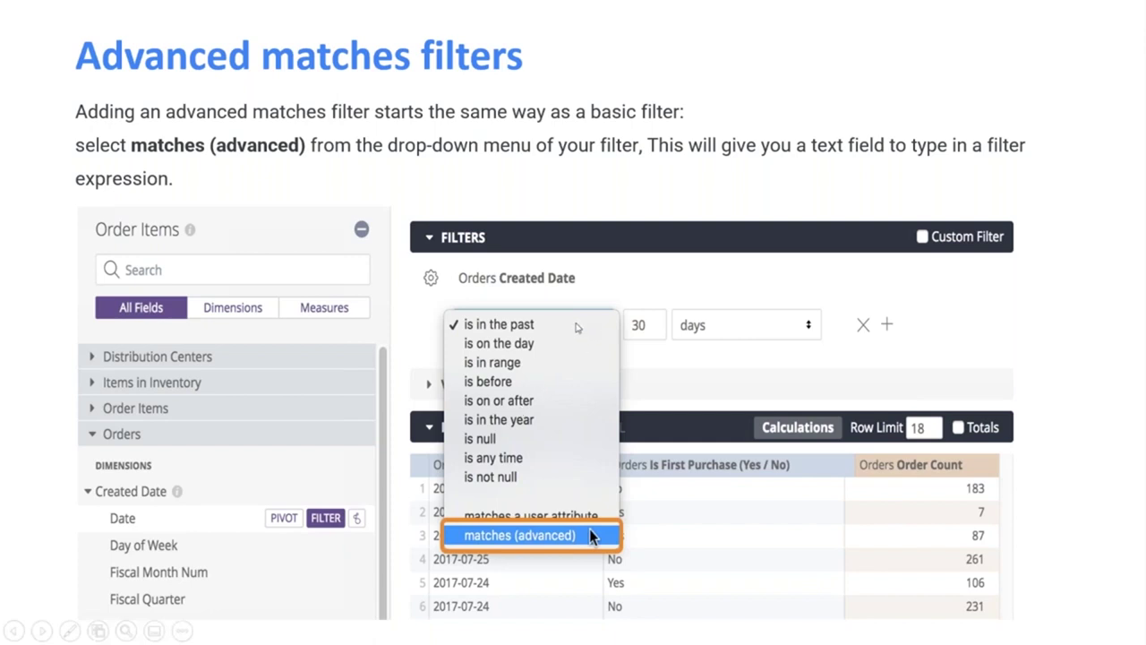

Slide 14
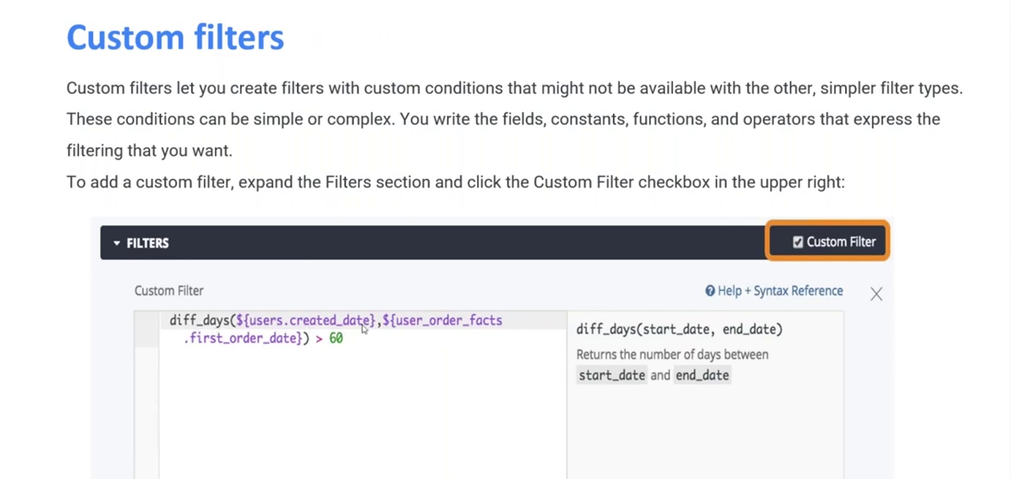

Slide 15
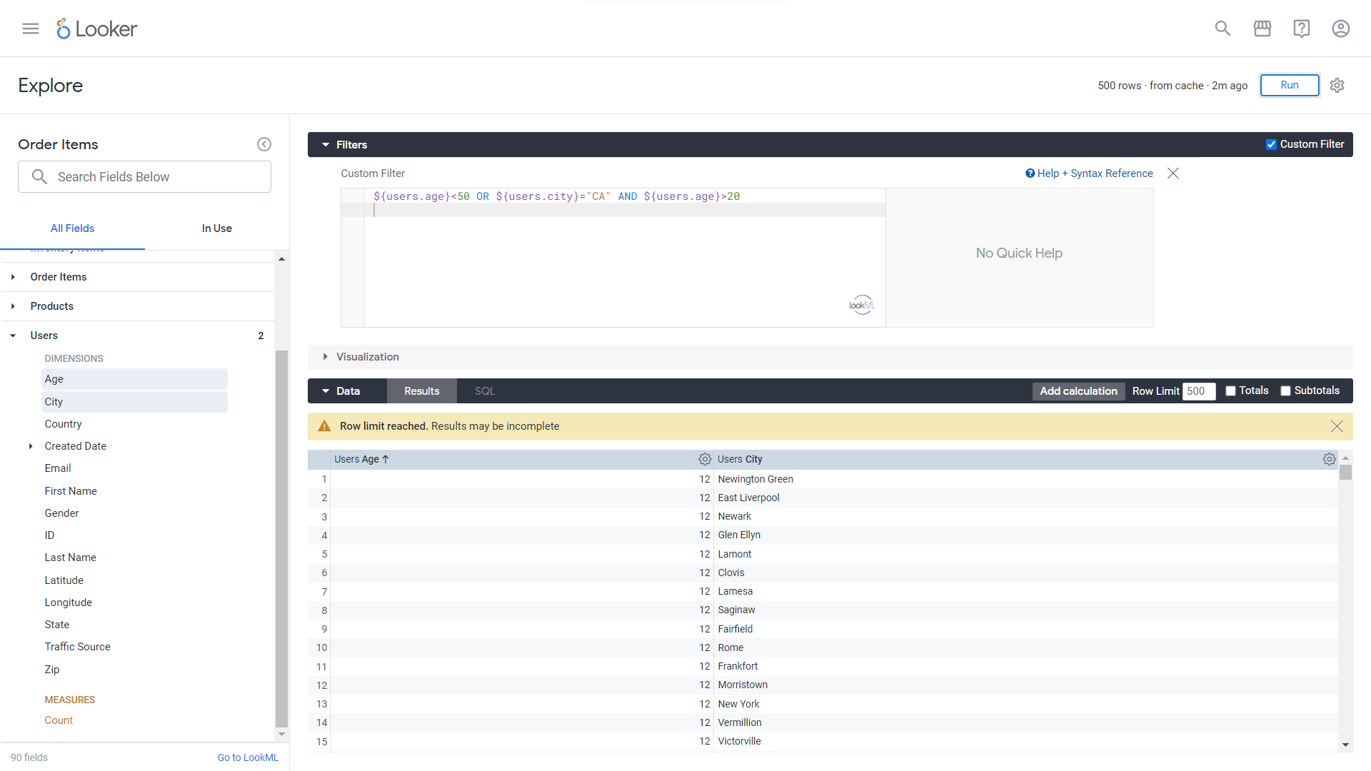

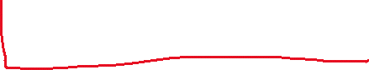
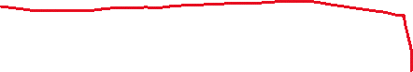


Slide 16
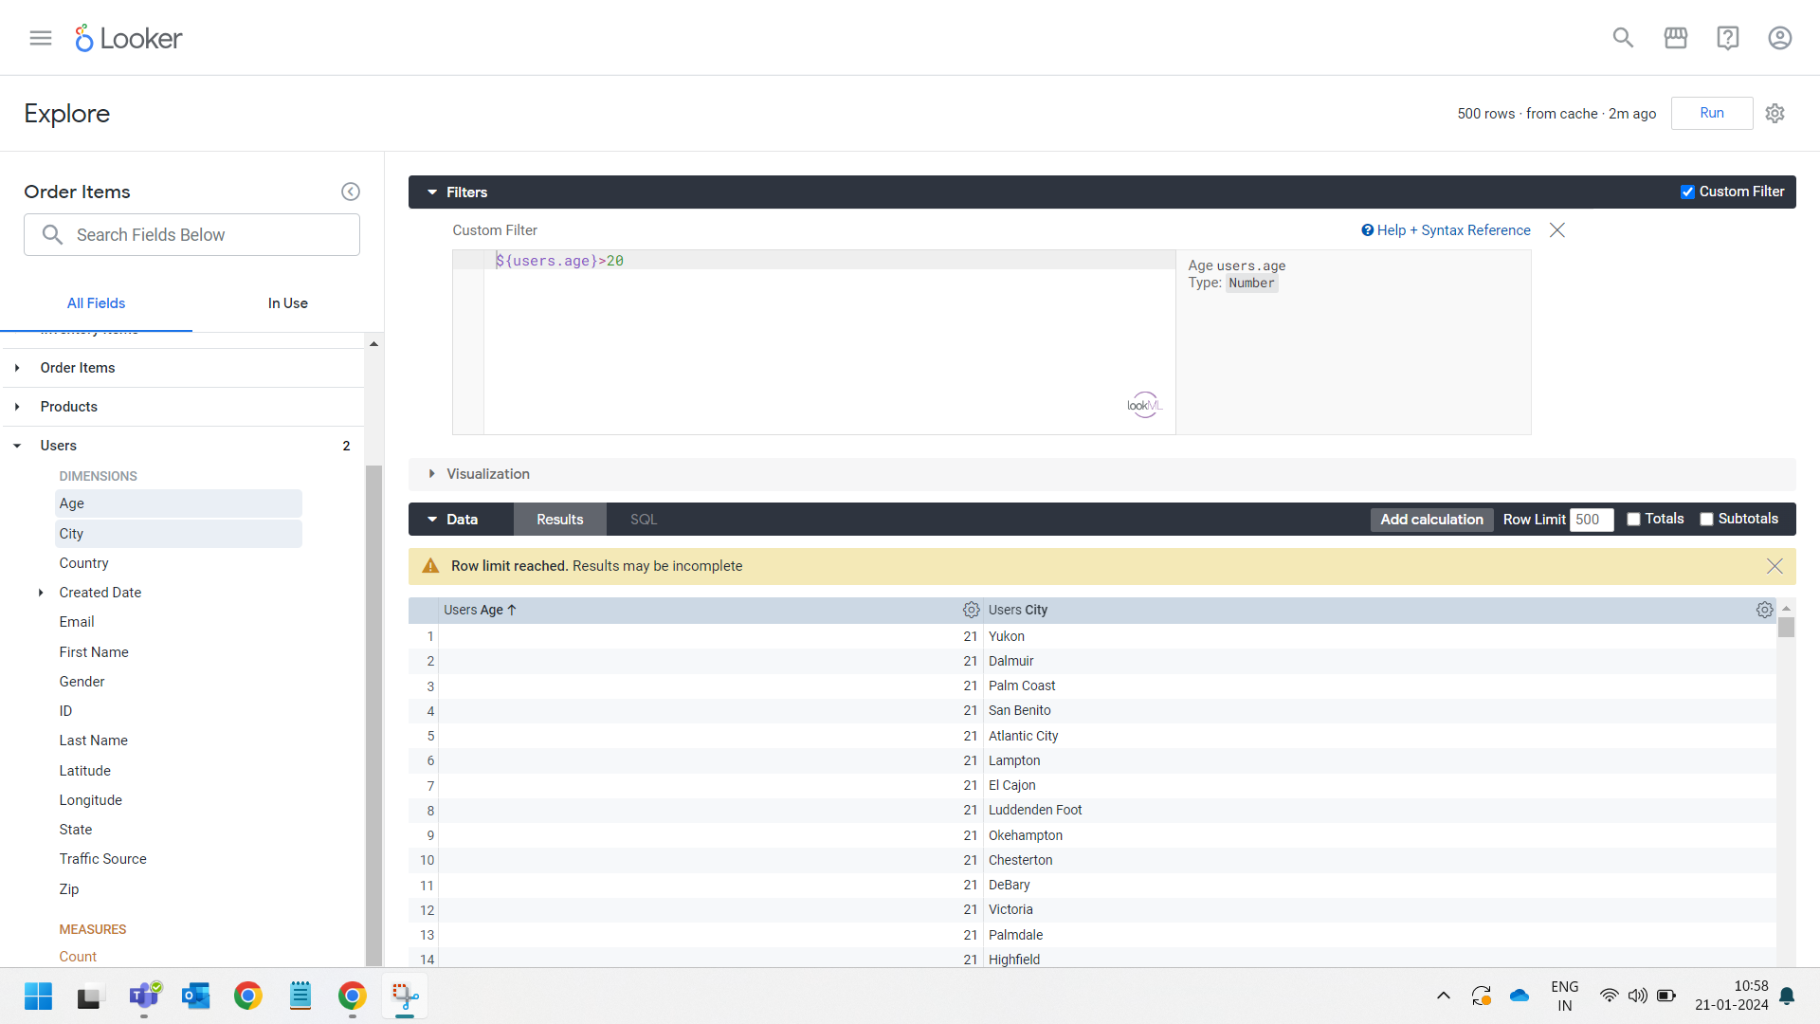







Slide 17
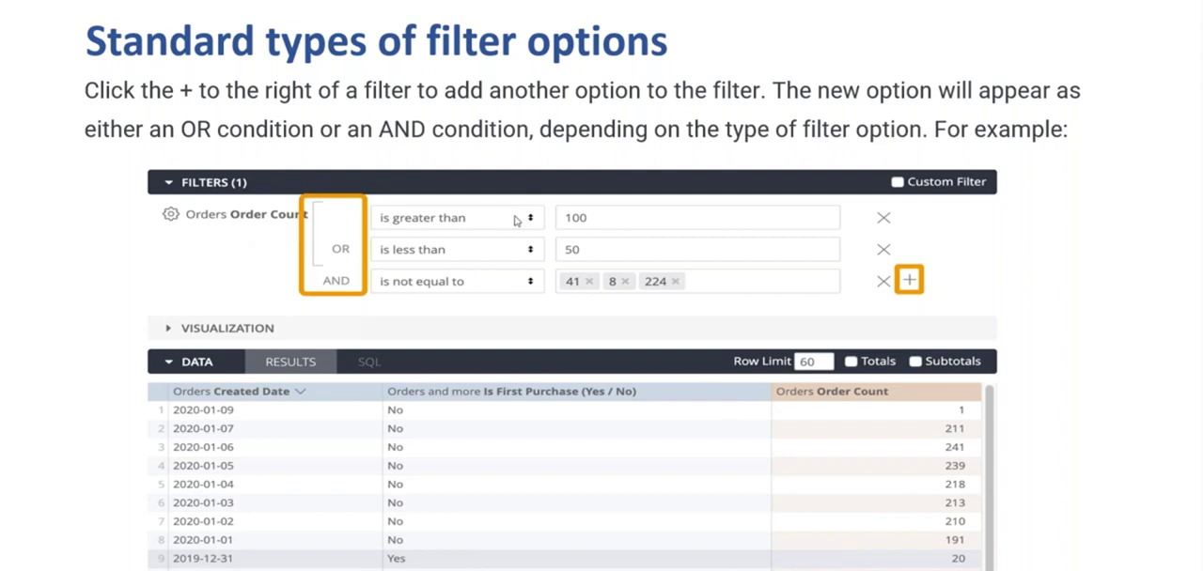

Slide 18
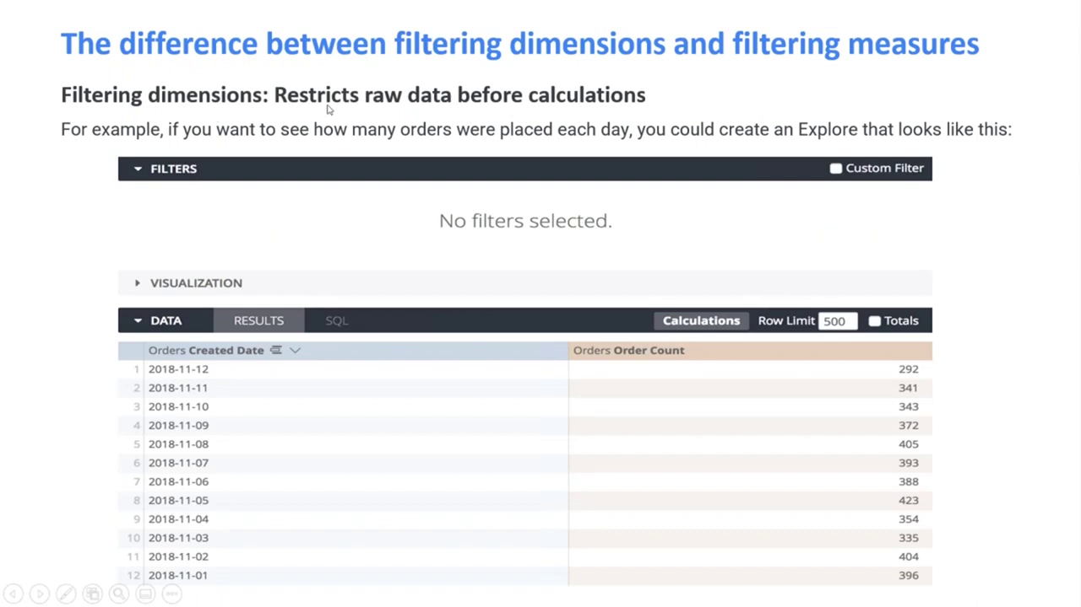

Slide 19
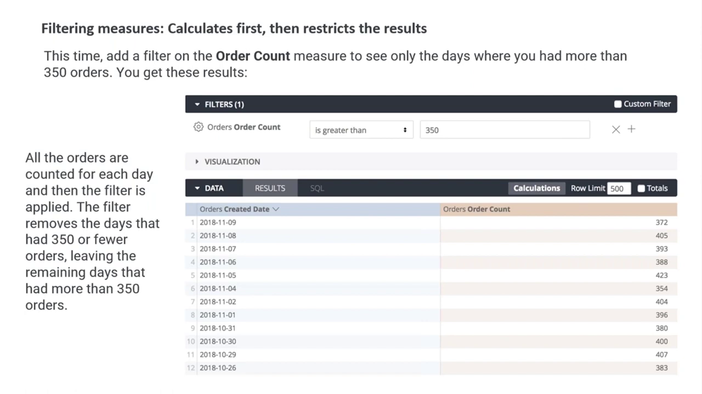

Slide 20
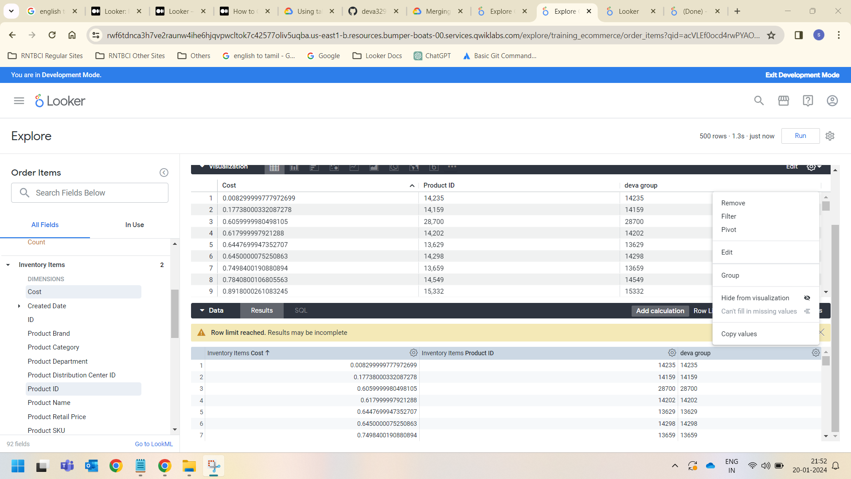

Group Filters in Datasets:

Slide 21
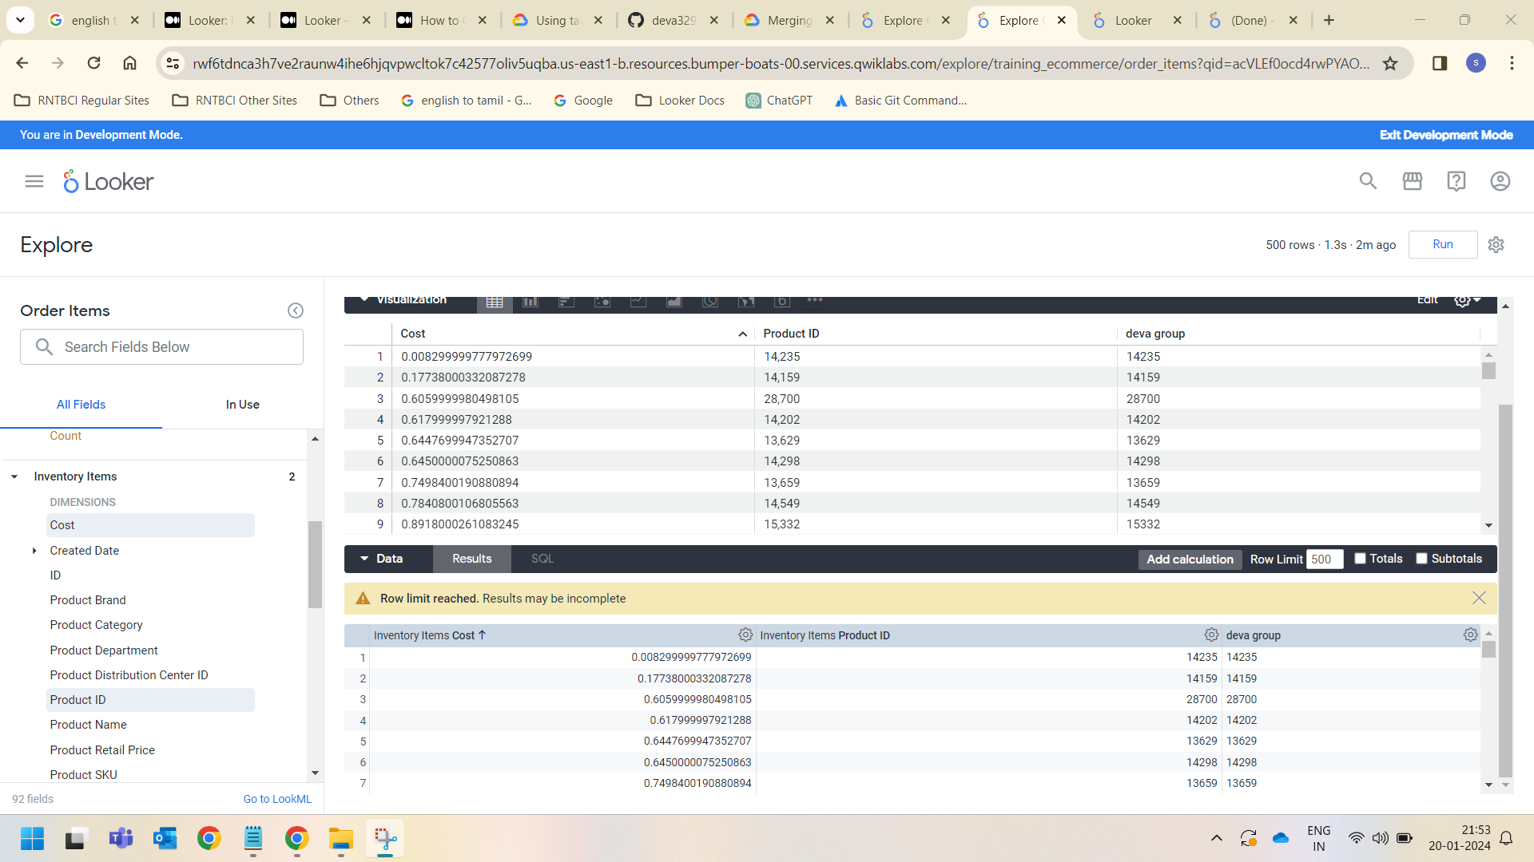



Slide 22
Types of Folders in Looker Visualization
There are four types of folders in Looker:
My Folder
Shared folder
LookML Dashboards
People
My Folder
This is your personal folder where you can save Dashboards and Looks.
Shared Folders – (Contains Customer Metrics folder)
Folders contain Dashboards and Looks for specific groups of people. You can copy, move, or save Dashboards and
Looks to a folder(your organization folder)
LookMl Dashboards Folder –
This section contains Dashboards that developers created using LookML
People Folder has Two types
Developer Student’s folder
Looker admin

Slide 23
Presenting content with boards
Boards in Looker provide a way for teams to find curated dashboards and Looks. Dashboards and Looks, which are stored in folders, can be added to multiple boards. Boards provide a way for users to perform the following tasks:
Add Looks and dashboards to boards to make it easier for users to find the information that is most relevant to them
Add links and descriptions to provide context and to guide users to resources
Users will only see boards that they have access to view. A user must have the View access level to see a board. Users with the Manage Access, Edit access level can add dashboards and Looks to the board and provide context for that content to help guide other users.
Viewing and managing access to a board
Access to boards and the content that is added to them, like Looks or dashboards, depends on a user's or group's board access, their access to the folder in which that content is stored, and the model that the Look or dashboard is based on.
If a user doesn't have folder access for viewing a dashboard or Look, that dashboard or Look will not be displayed to that user on the board. If the user has folder access but not model access, they will see a thumbnail but will not be able to view the underlying Look or dashboard.
Board access levels
There are two access levels that can be assigned to a user or group for a board: View and Manage Access, Edit.
With the View access level, a user can see that the board exists, add the board to their list, and view any board content that they have access to view.
With the Manage Access, Edit access level, a user can do everything that the View access level allows and can also make the following changes to the board:
Manage access to the board
Organize and manage content on the board
Add and remove Looks, dashboards, and links
Delete the board

Slide 24
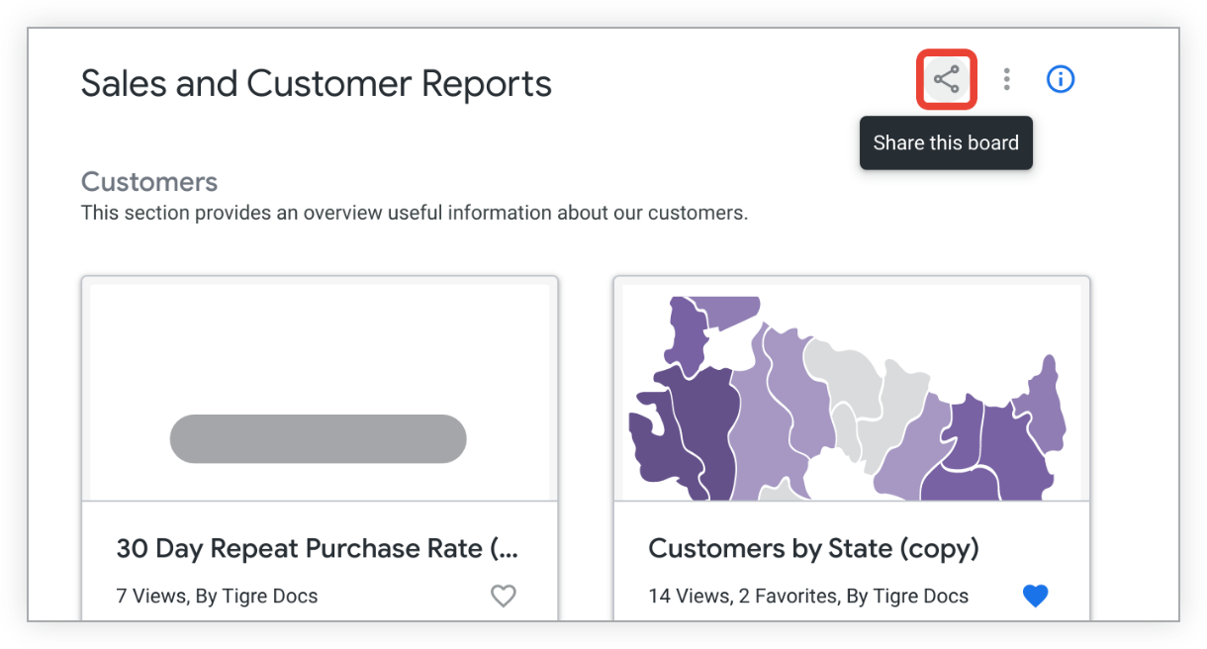
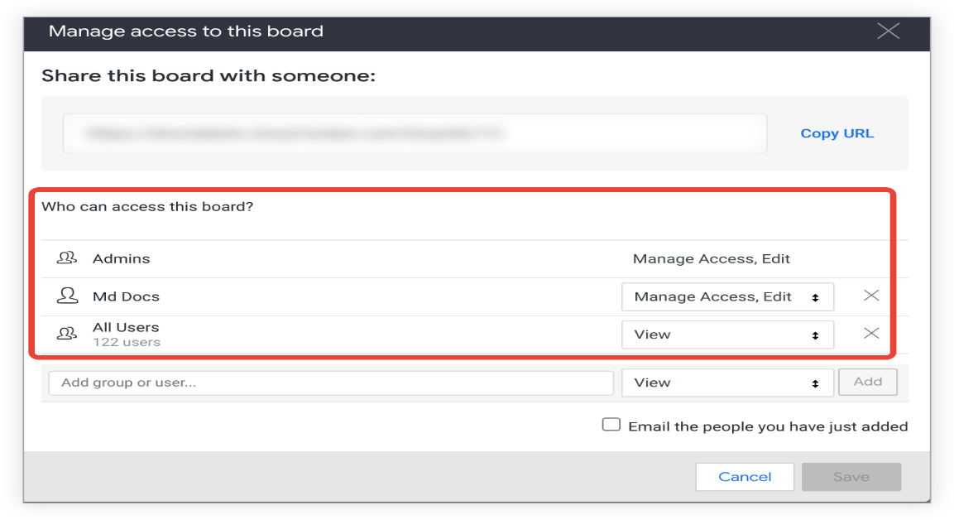
Viewing the access levels for a board
You must have the Manage Access, Edit access level for a board to view the access levels that other users and groups have for it. To see who can access a board:
Navigate to the board and select the share icon.
Looker displays the Manage access window for the board.
The Who can access this board section of the window lists users and groups who have access to the board as well as their access levels.
Managing the access levels for a board
To manage access to a board, you need the Manage Access, Edit access level for that board. To make changes to the access level that a group or user has for a board:
Navigate to the board and view its access levels by selecting the share icon.
To change the access level for a user or group that is already listed, select their current access level and choose the desired access level from the menu. You cannot change the ability of Looker admins to manage the board.

Slide 25
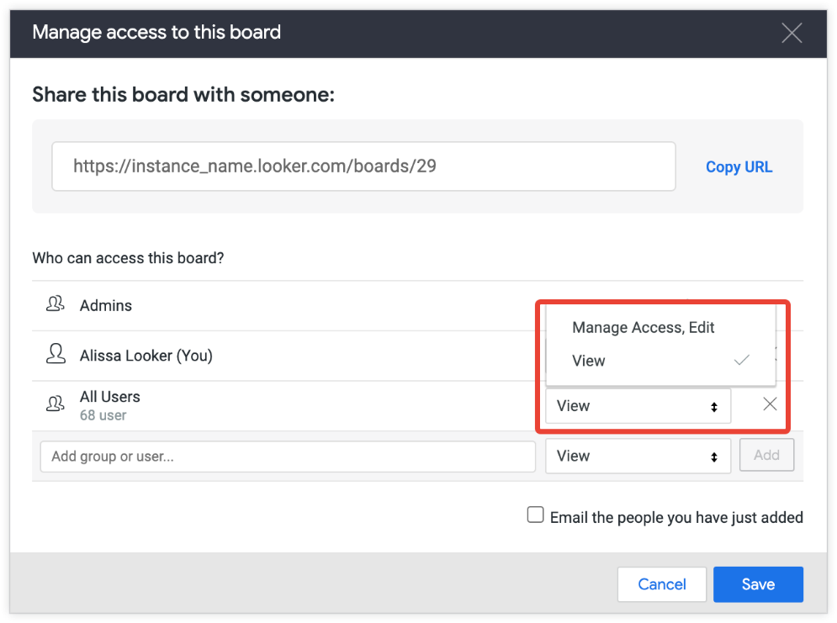
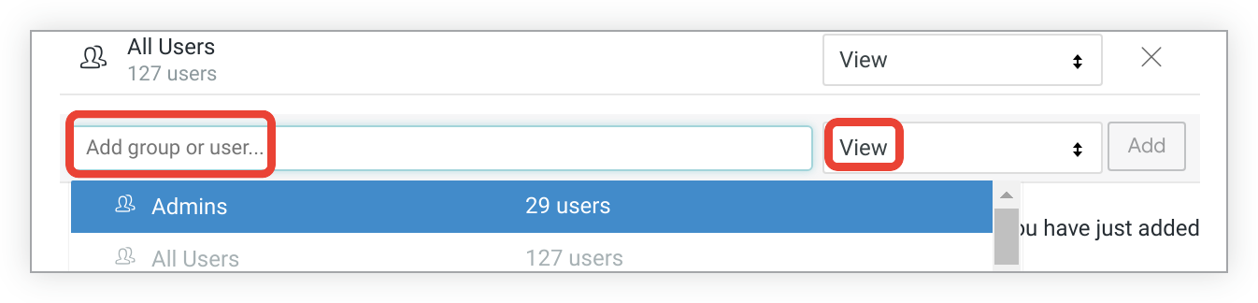
Remove user or group access by clicking the X to the right of the name.
Add one or more groups by selecting the Add group or user field and choosing any groups or users that you want to change.
For any users or groups whose access you want to change, select the existing access level and choose the desired access level from the drop-down menu.
Save your changes by selecting Save.
Creating a board
By default, when a board is created, admins and the creator have the Manage Access, Edit access level. All other users can interact with the board at the View access level.
To create a new board:
Select the Create or find a board plus icon next to the Boards option in the left navigation panel, and then select Create a new board.
In the Name section of the Create board window, enter a name for your board and select Create Board.

Slide 26
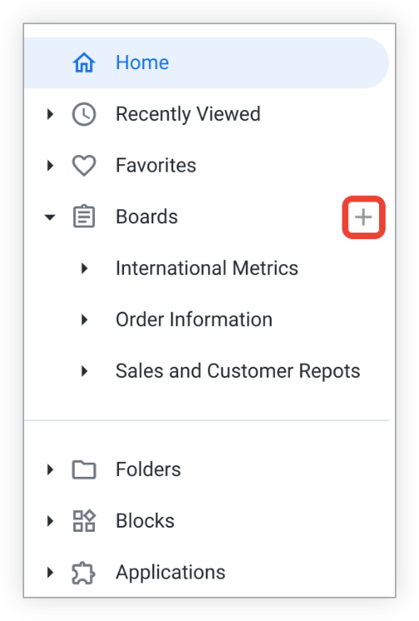
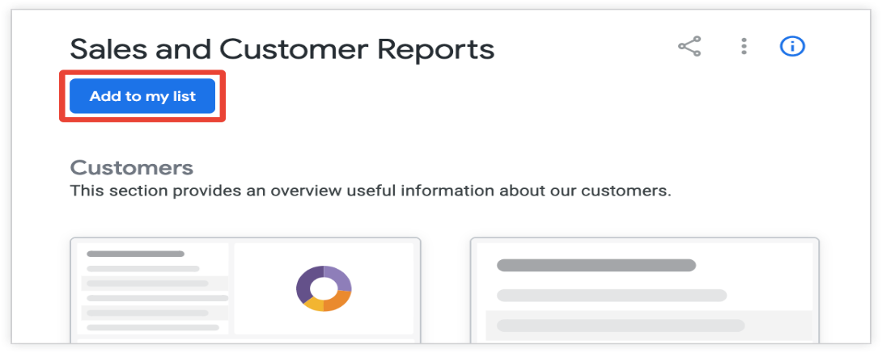
Looker adds the new board to your list in the left sidebar in Browse. As the creator of the board, you will also be listed as a contributor in the Contributors section of the
About this board information panel.
You can now manage the content on the board in a number of ways, including:
Adding sections
Adding content
Adding a description
Managing access to the board
Adding a board to your list
You can create a shortcut to a board that was created by another user by adding it to a personal list of boards, similar to a "Favorites" section. When you add a board to your list, it will be
listed on the left sidebar under Browse when you browse content in Looker.
To add a board to your list, select Add to my list beneath the title of the board.
To remove a board from your list, select the board's three-dot Board options menu and choose Remove from my list.

Slide 27
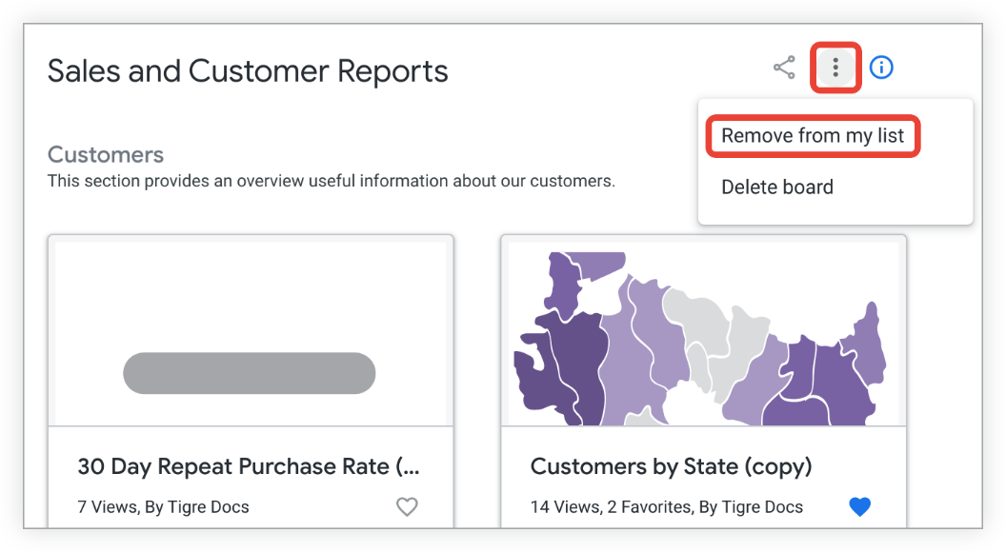
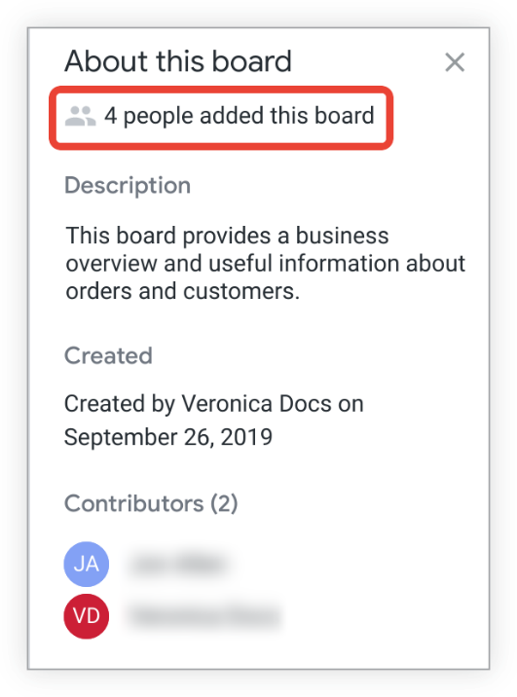
You can also remove a board from your list by selecting the three-dot menu that appears when you hover over a board in the left navigation panel and choosing Remove from sidebar.
The number of users who have added a board to their list is reflected in the About this board section of the board's information section.
Arranging content on a board
To arrange the content on a board, you must have the Manage Access, Edit access level. In addition to adding content to a board, contributors to a board can arrange the content on a board in the following ways:
Add sections
Reorder sections

Slide 28
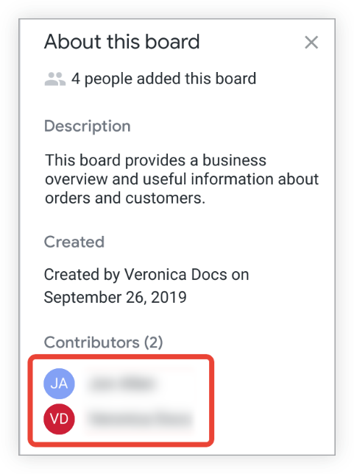
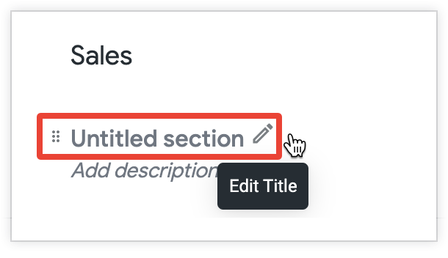
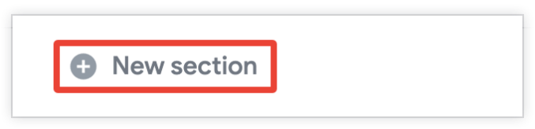
Remove sections
Move content within sections
Drag and drop content between sections
If you make changes to a board, you will be listed as a contributor in the Contributors section of the About this board information panel.
Adding sections to a board
When you create a board, there is a default section named Untitled section. To edit the title of the section, choose the Edit Title pencil icon to the right of Untitled section, and enter a new title.
To add a new section to a board, select New section at the bottom of your board. Enter a name for your new section, and press Enter (Windows) or return (Mac) to save the name.
You can now begin to add content to the new section.

Slide 29
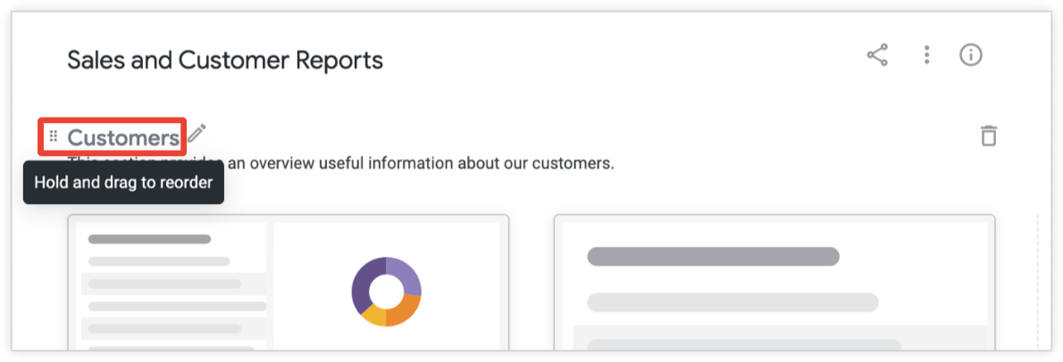
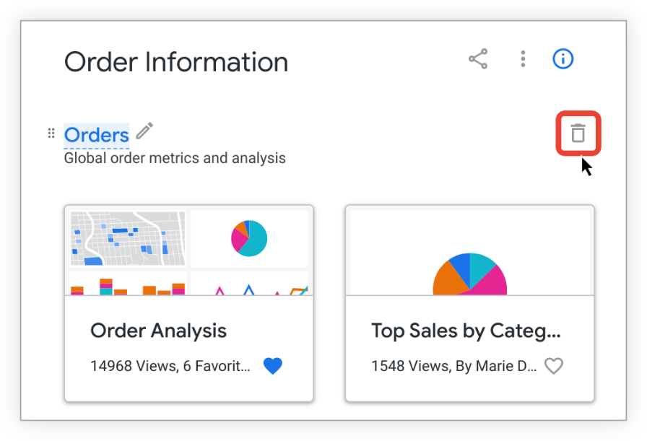
Reordering sections on a board
To change the order of the sections on a board:
Hover your cursor over the section you want to move and select the vertical six-dot icon to the left of the section title.
2.Holding the vertical six-dot icon, drag the section to position it above or below another section.
Removing sections from a board
If you have the Manage Access, Edit access level for a board, you can also delete its sections. To remove a section from a board:
1.Select the trash icon for the section you want to delete:
2.Looker displays a pop-up to confirm that you want to delete the section. Select Delete to delete the section.
Removing a section from a board also removes any Looks, dashboards, or links that have been added to the board in that section. However, the Looks and dashboards still exist in their folders.

Slide 30
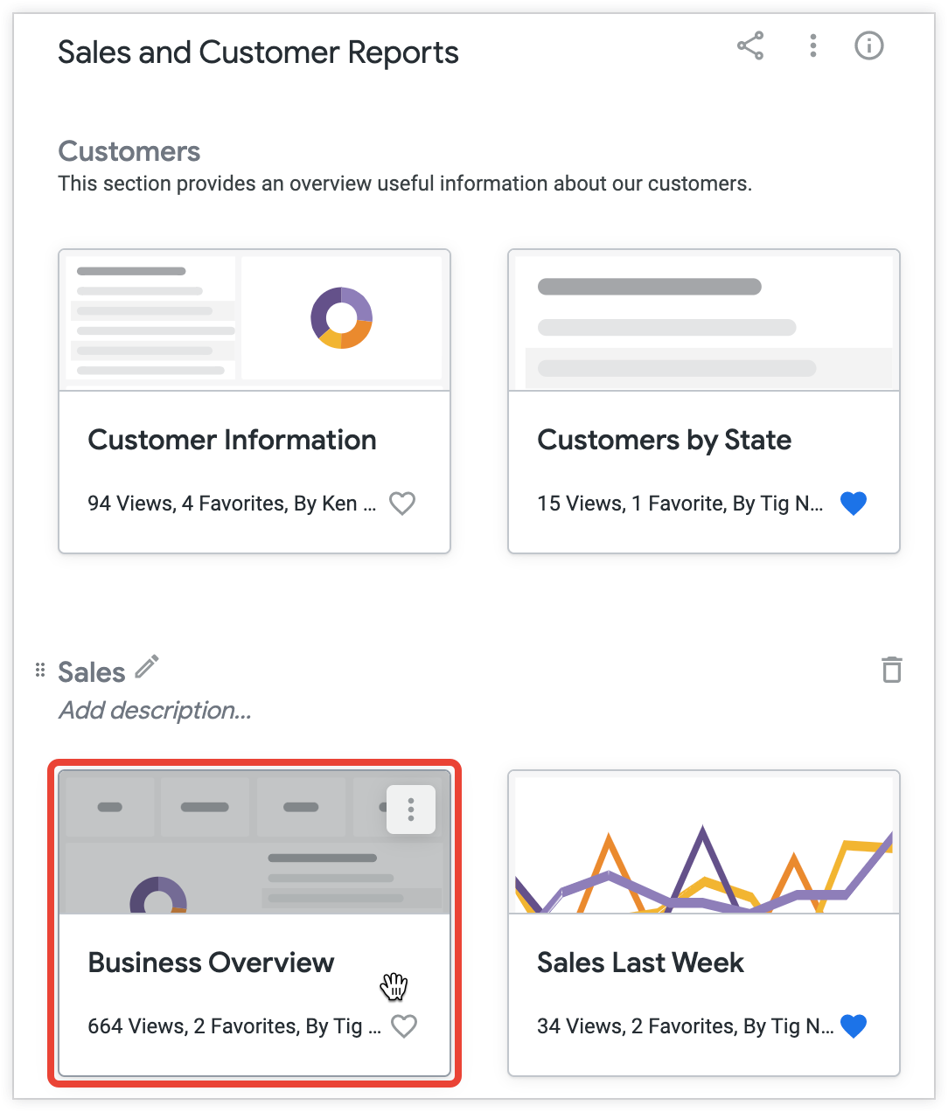
Moving content within sections on a board
To change the order of content within a section of a board:
Click on the content that you want to move.
Holding the added content, drag and drop it to move it to the desired position within the same section.
Moving content between the sections of a board
You can move content from one section to another by dragging and dropping the content you want to move. To move content from one section to another:
Select the content that you want to move.
Holding the content, drag it until it is positioned within the desired section of the board. If you hover over the new section while holding the content you are moving, Looker displays a message informing you that the content will be placed at the end of the section.
Drop the content into the desired section.
Adding descriptions to a board
For boards that you have created or for which you have the Manage Access, Edit access level, you can add a description that will appear in the board's information panel and in the window that Looker displays when you view all boards. You can also add a description to each section of a board.

Slide 31
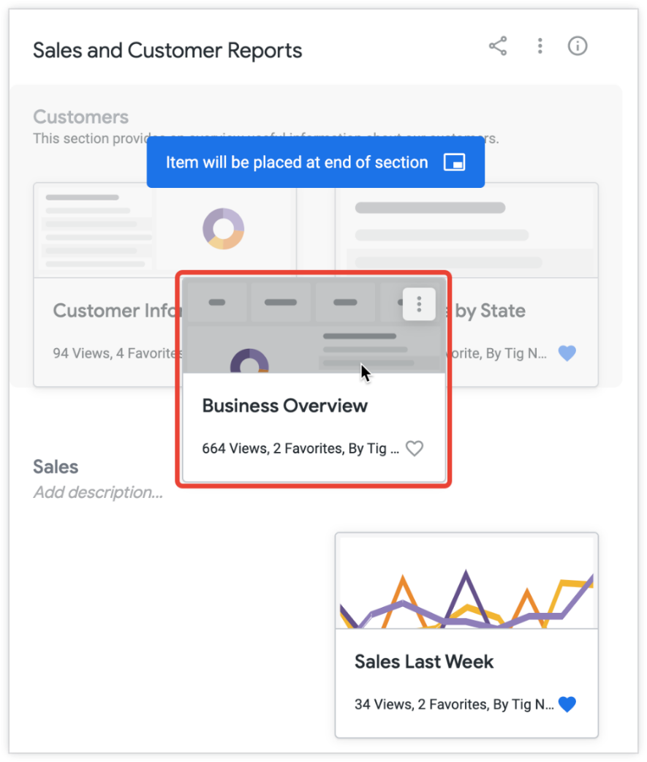
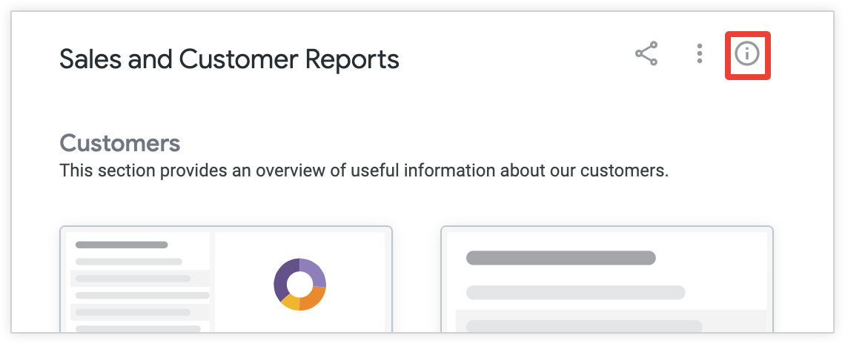
Adding a description for the entire board
In the About this board information panel of a board, you can add a text description that will appear in the Description section.
This description can be seen by anyone who can view the board and is a great way to give people context around the data added to the board.
Your description can be up to 250 characters and can include URLs and Markdown links.
To add or edit a board's description:
Select the Board Information icon at the top of the board to open the board's information panel.
2.Under Description in the information panel, select the Add a description text to add a new description.

Slide 32
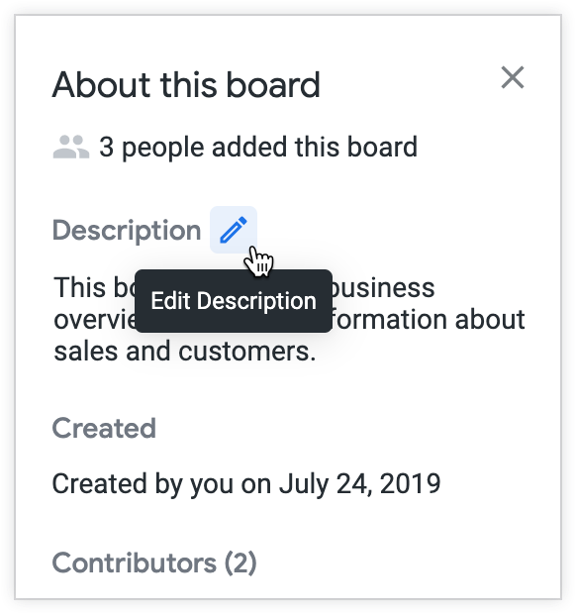
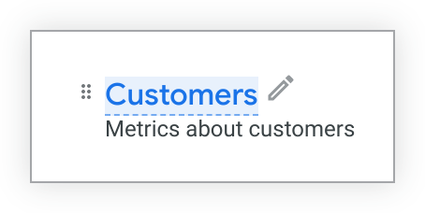
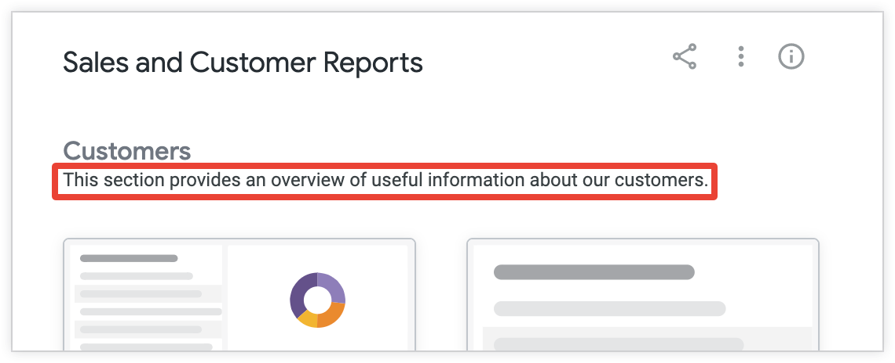
3.To edit an existing description, hover over the description and select the Edit Description pencil icon.
4.Add a description in the Description section and select Done to save the description.
Adding descriptions to the sections of a board
You can add or edit descriptions for each of the sections of a board that you have created or for which you have the Manage Access, Edit access level. To add or edit a description to one of a board's sections:
Select the Add description text beneath the section title.
2.Type in a description of up to 1,300 characters for the section, and press Enter (Windows) or return (Mac) to save the description.
3.The description you have added will appear beneath the title of the section.

Slide 33
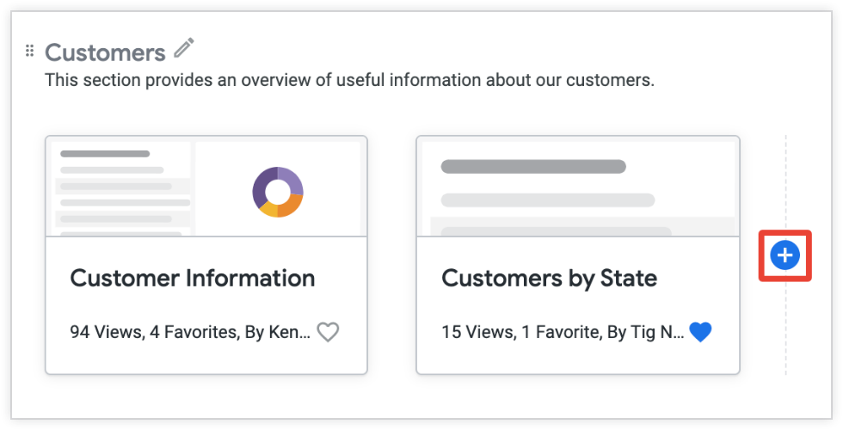
Users with Manage Access, Edit access to a board can modify an existing section description by selecting the existing text and performing the previous steps.
Adding content to a board
You can add content to a board that you created or have access to edit. You can also remove content from a board once it has been added.
Other users will be able to see and interact with added content if they have access to it. Because content is stored in folders rather than on boards, adding and removing content from boards does not actually affect the underlying content.
If you add content to a board, you will be listed as a contributor in the Contributors section of the About this board information panel.
Adding Looks and dashboards to a board
You can add a dashboard to one or more boards by selecting the Add to boards icon on a dashboard.
You can also add Looks and user-defined dashboards to a board in the following ways:
By adding from the board
By adding from a Look or dashboard's thumbnail in a folder
By adding from a Look's Explore actions gear menu or a dashboard's three-dot Dashboard actions menu
You can also add a LookML dashboard to a board from the thumbnail in the LookML dashboards folder or from the three-dot Dashboard actions menu of the LookML dashboard that you are viewing.
Adding from a board
To add a Look or user-defined dashboard to a board while you are viewing or editing the board:
If the section already has content, hover over the section and select the + (plus) icon.

Slide 34
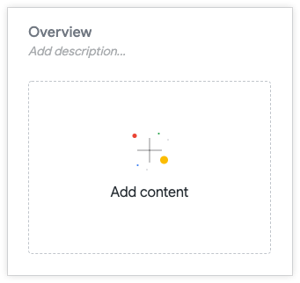
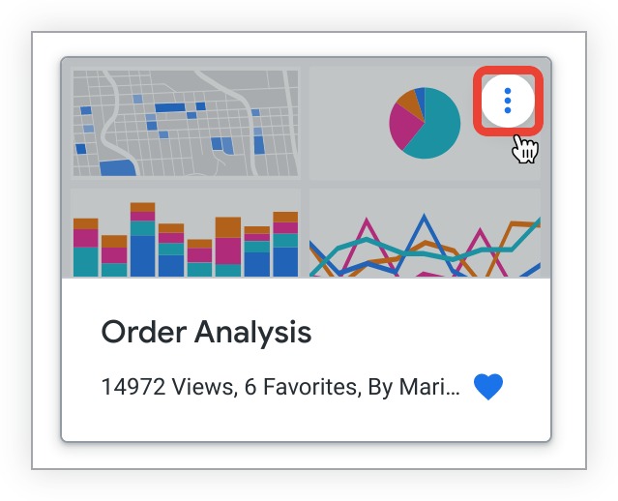
If the section doesn't have any content, select the Add content tile.
Select Saved content from the pop-up.
In the Add saved content window, select the Look or dashboard that you want to add to the board. The Look or dashboard you have selected will now appear in the section that you have chosen.
Adding from a folder
To add a Look, user-defined dashboard, or LookML dashboard to a board from a folder:
In a folder, select the three-dot menu on the thumbnail for the dashboard or Look that you want to add to a board, and choose Add to a board from the drop-down menu.
Choose an existing board and section from the Select a board and Select a section in the board drop-down menus, and select Add.
Adding from a Look or dashboard
To add a Look that you are viewing to a board:
Select the Look's Explore actions gear menu and choose Add to a board.
Choose an existing board and section from the Select a board and Select a section in the board drop-down menus, and select Add.

Slide 35
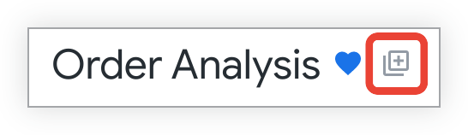
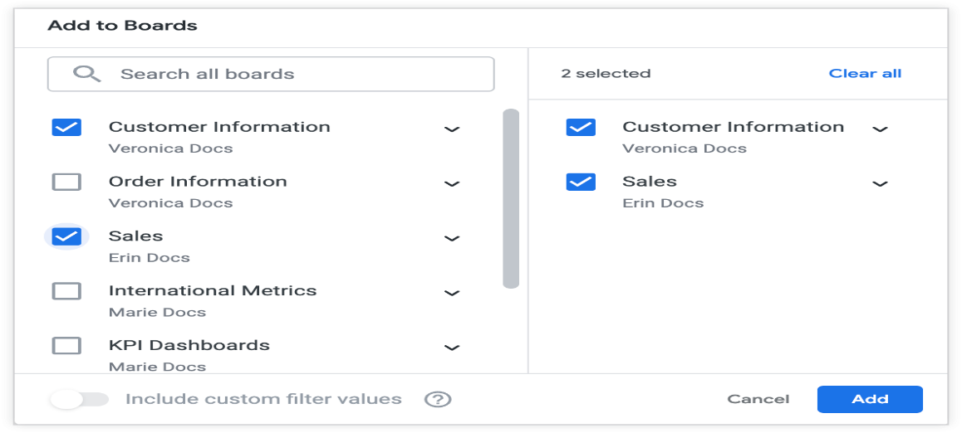
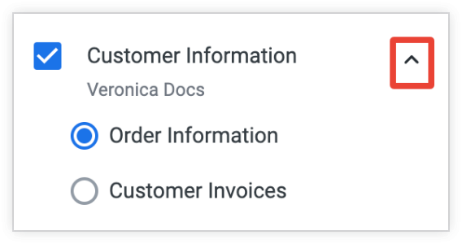
To add a user-defined dashboard or a LookML dashboard to a board:
Select the Dashboard actions three-dot menu, and choose Add to a board. This opens the Add to Boards window, where you can choose one or more boards to which you want to add the dashboard.
In the Add to Boards window, select the checkboxes for any boards to which you want to add the dashboard. See the Adding with the Add to boards icon section of this page for more information on the actions you can take with the Add to Boards window.
Adding with the Add to boards icon
You can add a dashboard to a board by selecting the Add to boards icon on the dashboard, which is located to the right of the dashboard title and the heart-shaped favorites indicator:
Selecting the Add to boards icon opens the Add to Boards window, where you can choose one or more boards to which you want to add the dashboard.
Select the checkboxes for any boards to which you want to add the dashboard:
You can also add dashboards to specific sections on one or more boards. Select the arrow beside the name of the board to expand the list of sections on that board.
Then select the sections to which you want to add the dashboard:

Slide 36
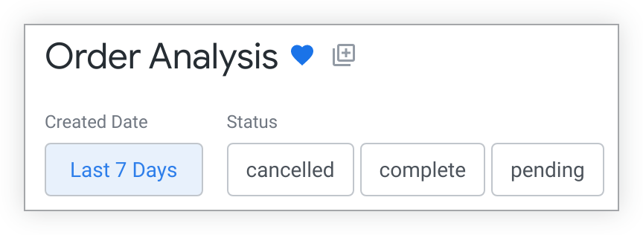
Any boards that you have selected appear in the right-hand pane of the Add to Boards window.
Adding dashboards to boards with custom filter values applied
If you have made any temporary changes to the filters on a dashboard that you are saving to one or more boards, you can choose whether the dashboard will be saved to those boards with its default filter values or with the current filter values applied.
To save a dashboard to one or more boards with its default filter values applied, disable the Include custom filter values toggle. The Include custom filter values toggle is disabled by default.
To save a dashboard to one or more boards with custom filter values applied, enable the Include custom filter values toggle.
For example, suppose you have an Order Analysis dashboard with a filter on the field Created Date. In this example, the default value for the filter on the Created Date field is Last 7 Days:
If you temporarily change the value of the filter on the Created Date to Last 14 Days, the dashboard will display values for the last 14 days, but this will not affect anyone else's filter results. However, if you enable the Include custom filter values toggle when you save the Order Analysis dashboard to one or more boards, the Order Analysis dashboard will be saved to those boards with the custom filter on Last 14 Days, rather than on its default value of Last 7 Days.
Adding links to a board
You can add URLs to boards by using the following method:
If the section already has added content, hover over the section and select the Add content plus icon.
If the section doesn't have any content, select the Add content tile.
Select URL Link from the pop-up.
In the Link field, paste or enter the URL that you want to add to your board.
If the URL you used is to a Look or dashboard, the Title and Description fields will be filled in automatically.
Otherwise, add a Title for the link, and, if desired, add a Description of up to 255 characters.

Slide 37
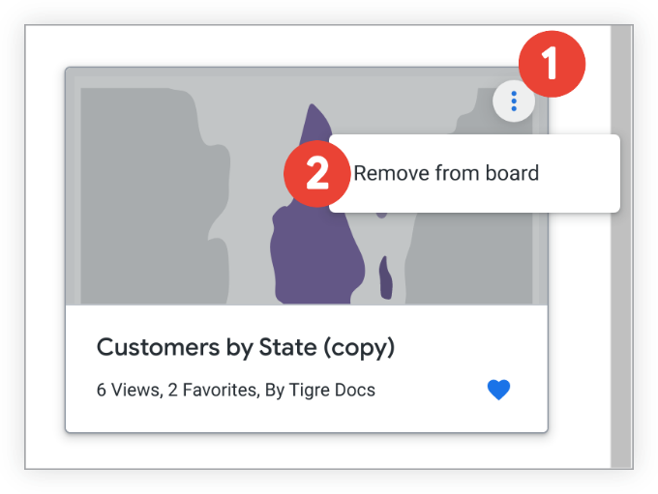
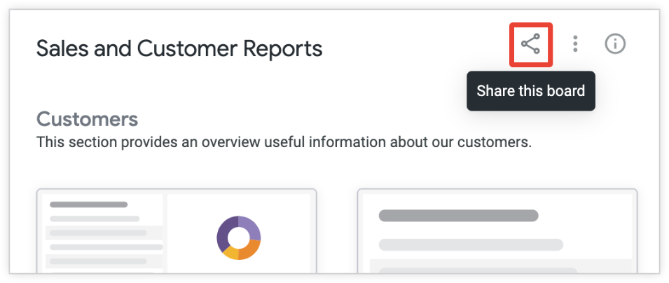
3.If you added a Looker dashboard URL with custom filters applied, the option to Include custom filter values in URL will appear. When this option is enabled, the dashboard link uses the custom filter values. When this option is disabled, the link excludes any custom filter values and uses the default filter values.
It is possible to include multiple tiles on a board that reference the same dashboard, but with different filter values set for each tile. However, each of these tiles will use the same title and description, which could make it confusing for users to navigate a board.
4.Click Add to include the link.
Removing content from a board
To remove content from a board:
Select the three-dot Options menu at the top right of the content.
Choose Remove from board.
If you remove a section from a board, any Looks, dashboards, and links in that section will also be removed.
Sharing a board
You can share boards for which you have the Manage Access, Edit access level by sharing a link to the board or by sending an email notification. Users must have at least the View access level for a board in order to view it.
Sharing a link to a board
To obtain a link to a board that you can share with others:
Navigate to the board and select the share icon.
In the Manage access window, under Share this board with someone,
select and copy the URL field, or click Copy URL.

Slide 38
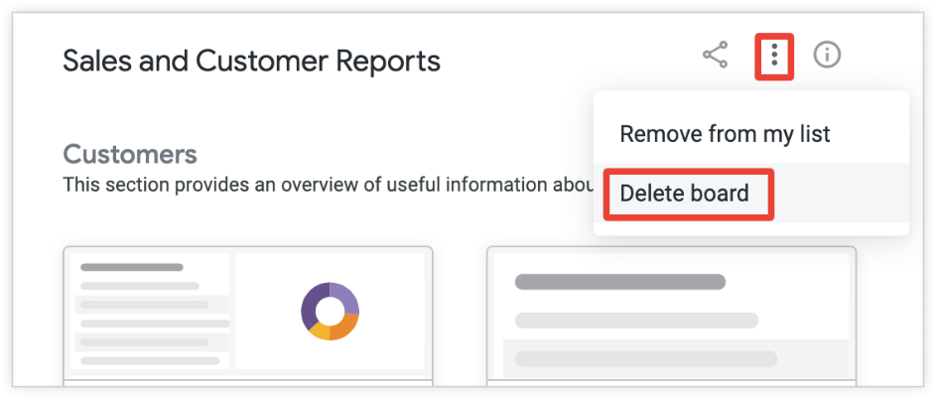
Sending an email notification
When you grant a user access to a board, you are given the option of sending that user an email notification.
If you add a user group to a board, however, email notifications will not be sent
to the members of the group unless you also add the group members as individual users. To send an email notification:
In the Manage access window for the board, grant access to the user.
Select the Email the people you have just added checkbox in the Manage access window.
Select Save.
Individual users you have added to the board will receive an email notifying them that they have been granted View or Manage Access, Edit access to the board.
The email also invites users to view the board and encourages them to add it to their lists.
Deleting a board
When you delete a board, you will not be able to recover it.
To delete a board, you must have the Manage Access, Edit access level.
Deleting a board will not delete the Looks and dashboards that are added to the board, as they are stored in folders. To delete a board:
Select the board's three-dot Board options menu, and choose Delete board.
2.Confirm that you want to delete the board in the window that Looker displays.

Slide 39
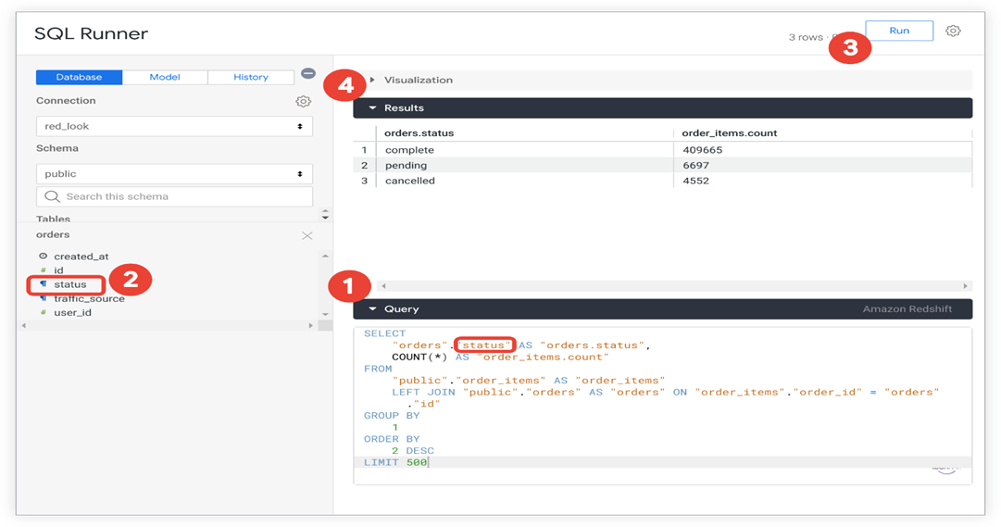
SQL Runner
Using SQL Runner to create queries and Explores
SQL Runner provides a way to directly access your database and leverage that access in a variety of ways. Using SQL Runner, you can easily navigate the tables in your schema, use an ad hoc Explore from a SQL query, run prewritten descriptive queries on your data, see your SQL Runner history, download results, share queries, add to a LookML Project as a derived table, and perform other useful tasks.
This page describes how to run queries in SQL Runner, create ad hoc Explores, and how to use SQL Runner to debug queries. See these other documentation pages for information on:
SQL Runner basics
Using SQL Runner to create derived tables
Managing database functions with SQL Runner
Running queries in SQL Runner
To run a query on your database, you can write the SQL query from scratch, use an Explore to create the query, or run a query against a LookML model. You can also use the history to rerun a previous query.
Writing a SQL query from scratch
You can use SQL Runner to write and run your own SQL queries against your database. Looker passes your query to your database just as you have written it, so be sure that the syntax of your SQL query is valid for your database dialect. For example, each dialect has slightly different SQL functions with specific parameters that should be passed to the function.

Slide 40
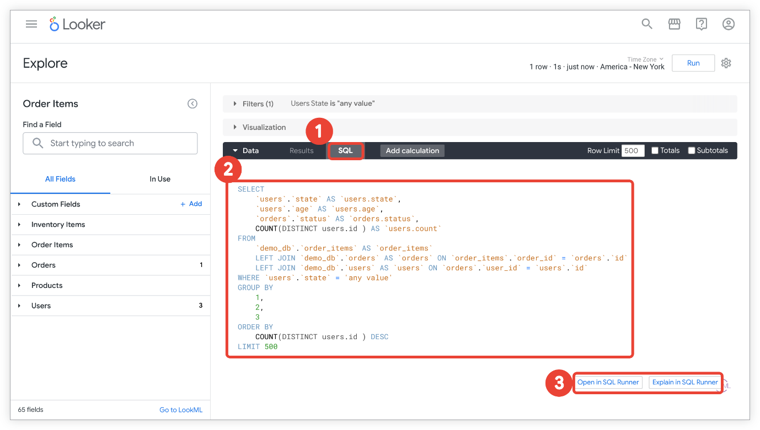
Enter a SQL query in the text box below the Query bar.
Optionally, select a table name or field from the field list to include it in your query at the cursor location.
Select Run to run the query against your database.
View the results in the Results area. SQL Runner will load up to 5,000 rows of the query's result set. For SQL dialects that support streaming, you can download the results to see the entire result set.
Some SQL programs will let you run multiple queries in a series. However, you can only run one query at a time in SQL Runner. SQL Runner also has a 65,535 character limit on queries, including white space.
After running a query, you can add the query to a project, get the LookML for a derived table, or share the query.
You can also use SQL Runner to play with new queries or test existing queries. SQL Runner error highlighting helps test and debug queries.
Using an Explore to create a SQL query
You also can use an Explore to create a query, then get the SQL command for that query to use in SQL Runner:
From an Explore, select the SQL tab from the Data bar.
The SQL query will appear under the Data bar.
Select Open in SQL Runner or Explain in SQL Runner to
open the query in SQL Runner.
Once a query is added to the text box below the Query bar,
you can select Run to query the database.
Alternatively, you can edit the query and then run the new query.

Slide 41
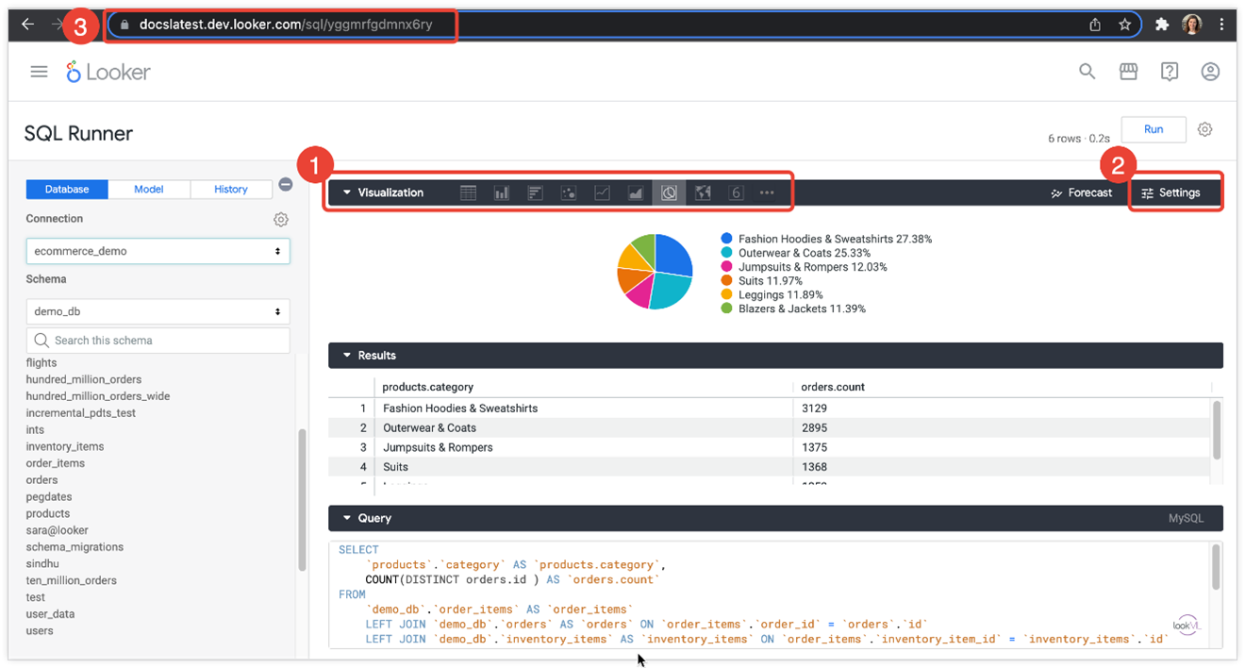
Creating visualizations with SQL Runner
If your Looker admin has enabled the SQL Runner Vis Labs feature, you can create visualizations directly in SQL Runner.With SQL Runner Vis enabled, the SQL Runner panels are reorganized. The visualization panel appears at the top, the results panel is in the middle, and the query panel appears at the bottom.
After a SQL query is created and run, you can open the Visualization tab to view the visualization and choose a visualization type and You can edit the visualization using the Settings menu.
You can share visualizations created with SQL Runner by sharing the URL. Any customizations that you make using the visualization's Settings menu will be saved and the link will not change.
There are some things to keep in mind about how SQL Runner visualizations work:
The results table and visualization interpret any numeric field as a measure.
The full field name is always used in the results table and visualization. Therefore, the Show Full Field Name option in the Settings menu is inactive.
To use custom fields, table calculations, pivots, column totals, and subtotals, explore from your SQL Runner query.
Static map (regions) visualizations are not supported by SQL Runner visualizations, however maps that use latitude and longitude data (map and static map (points) visualizations) are supported and Timeline visualizations are not supported by SQL Runner visualizations.

Slide 42

Looker resolves any LookML substitutions and then passes your query to your database, so the query should be in valid SQL for your database dialect. For example, each dialect has slightly different SQL functions with specific parameters that should be passed to the function
To run a query against your LookML model in SQL Runner:
Select the Model tab.
Select the model that you want to query.
In the text box under the Data bar, enter your SQL query by using LookML fields.
Optionally, select a view in the view list to include the view in your query at the cursor location.
To see the list of fields in a view, select the view in the Views section. Optionally, you can select a field in the field list to include it in your query at the cursor location.
In the Prepared SQL Query area, you can view the resulting SQL query that is built after any LookML substitutions have been translated to SQL.
Select Run to run the query against your model.
View the results in the Results area. SQL Runner loads up to 5,000 rows of the query's result set. For SQL dialects that support streaming, you can download the results to see the entire result set.
You can use SQL Runner to play with new queries, test existing queries, or open a new Explore from the results. SQL Runner error highlighting helps test and debug queries.

Slide 43

When you have a query that you like, you can share the query and even add the query to a LookML project.
Viewing a field's LookML from SQL Runner
From the field list in the Model tab, you can also see the LookML for a field. Hover over the field in the field list, and select the Looker icon to the right of the field name.
Looker opens up the LookML IDE, and loads the file where the field is defined.
SQL Runner history
You can also see a recent history of all queries you have run in SQL Runner.
To see your history, select the History tab at the top of the navigation pane. SQL Runner displays all the queries that were run on the database connection.
Red indicates a query that did not run because an error occurred.
Select a query in the history to populate that query into SQL Runner, and then select Run to rerun the query.
Sorting your query
A table's sort order is indicated by an upward or a downward arrow next to the sorted field name, depending on whether the results are in ascending or descending order.
You can sort by multiple columns by holding down the Shift key and then selecting the column headers in the order that you want them sorted.
A field's sort order is also indicated by a number that distinguishes its sort-by order as compared to other fields, by an arrow next to the field name
that shows the sorting direction (ascending or descending), and by a pop-up that appears when you hover over a field name.
Sharing queries
You can share a query in SQL Runner with another user who has SQL Runner access. To share a query, copy the URL in the address bar of your browser.
Downloading result
Once you have run your SQL query, you can download the results in a variety of formats.
Write a query in the SQL Query box. (You do not need to run the query in SQL Runner at this point.)

Slide 44

2.Select Download from the gear menu in the upper right.
3.Select the file format of the download (text file, CSV, JSON, etc.).
4.Select Open in Browser to see the results in a new browser window, or select Download to download the results to a file on your computer.
When you select either Open in Browser or Download, Looker will rerun the query and then perform the download.
For SQL dialects that support streaming, the SQL Runner Download option will download the entire result set. For SQL dialects that do not support streaming, the SQL Runner Download option will download only the rows of the query that are shown in the Results section (up to 5,000 rows).
Copying column values
You can copy column values from the Results section in SQL Runner. Select a column's gear menu to copy the values to your clipboard. From there you can paste the column values into a text file, an Excel spreadsheet, or another location.
If your Looker admin has enabled the SQL Runner Vis Labs feature, you have other options in the column gear menu as well:
Freeze and Unfreeze
Autosize All Columns
Reset All Column Widths
You can also manually move, pin and resize columns in the results table.

Slide 45


Cost estimates for SQL Runner queries
For BigQuery, MySQL, Amazon RDS for MySQL, Snowflake, Amazon Redshift, Amazon Aurora, PostgreSQL, Cloud SQL for PostgreSQL, and Microsoft Azure PostgreSQL connections, SQL Runner provides an estimate of the cost of the query. Once you enter the SQL query, SQL Runner will calculate the amount of data that the query will require and display the information near the Run button.
For BigQuery, MySQL, and Amazon RDS for MySQL connections, cost estimates are always enabled. For Snowflake, Amazon Redshift, Amazon Aurora, PostgreSQL, Cloud SQL for PostgreSQL, and Microsoft Azure PostgreSQL database connections, you must enable the Cost Estimate option for the connection. You can enable Cost Estimate when you create the connection
. For existing connections, you can edit the connection from the Connections page in the Database section of Looker's Admin panel.
Creating an ad hoc Explore
From SQL Runner you can get fast insight into the data by creating an ad hoc Explore for a SQL query or database table. You can use the Looker Explore to select fields, add filters, visualize the results, and create SQL queries.
There are two ways to open an ad hoc Explore from SQL Runner:
Explore from SQL Runner's query results
Explore from SQL Runner's table list

Slide 46


Exploring from SQL Runner query results
SQL Runner lets you open an Explore from a SQL query. This creates a temporary Explore from the query written in SQL Runner. That lets you test what is returned by the query, as well as visualize the results. This can be used for any query but is especially useful for testing queries you plan to use for derived tables.
If your Looker admin has enabled the SQL Runner Vis Labs feature, you can create visualizations directly in SQL Runner.
Use SQL Runner to create the SQL query that you want to use.
You can copy the URL to this Explore for sharing.
Select Explore from the gear menu in the upper right. This takes you to a new Explore, where you can explore the SQL query as if it were a saved table in your model.
To add this query as a derived table in your project directly from here, select Add View to Project
.
Creating custom fields while exploring in SQL Runner
If you have access to the custom fields feature, you can use custom fields to visualize unmodeled fields in SQL Runner. As described in the previous section, select Explore from the gear menu. Then, in the field picker, follow these steps:
Select the Custom Fields section to open it, and then select Add to begin creating a custom dimension, custom measure, or table calculation. (If you do not have the Custom Fields section, then you do not have access to create custom fields.)
Select a measure's three-dot More menu and choose Filter Measure to create a filtered custom measure from an existing measure.
Select a dimension's three-dot More menu and choose a measure type (like sum or count) to create a custom measure from a dimension

Slide 47

Exploring a table listed in SQL Runner
Use the Explore Table option in the Database tab to create an ad hoc Explore for any table in the connection. This lets you use Looker on a table before you've modeled it, exploring the table just like a LookML view.
Once you open an Explore for the table, you can decide whether to add the table to your project. You can also use the Explore's SQL tab to see the SQL queries that Looker sends to the database, and then use the Open in SQL Runner button to bring the query back into SQL Runner.
Select the Database tab.
In SQL Runner, select the gear for a table and then select Explore Table.
Looker generates a temporary model with a view for the table, then displays the Explore.
Looker provides a dimension field for each column in the table.
(This is the same way that Looker generates a model at the start of a project.)
5. Looker automatically includes timeframes for any date fields.
6. Looker also includes a count measure.
When using the Explore Table option, there is no LookML file associated with the Explore — it is just an ad hoc view of the table.
Debugging using SQL Runner
SQL Runner is also a useful tool for checking SQL errors in queries.
SQL Runner error highlighting
SQL Runner highlights the location of errors in the SQL command and includes the position of the error in the error message:

Slide 48


The position information provided will vary depending on the database dialect. For example, MySQL provides the line number that contains the error, while Redshift provides the
character position of the error. Other database dialects might have one of these or other behaviors.
SQL Runner also highlights the location of the first syntax error in the SQL command by underlining it in red and marking the row with an x.
Hover over the x to see more information on the error. After you fix that issue, select Run to see if there are any more errors in the query.
Using SQL Runner to check errors in Explores
If you run into SQL syntax errors in an Explore, you can use SQL Runner to determine the location of the error and the type of error, such as spelling mistakes or missing commands.
From the Explore, select the SQL tab of the Data bar.
2.Select Open in SQL Runner to open the query in SQL Runner.
This copies the Explore's generated SQL to SQL Runner. As shown above, SQL Runner highlights the location of errors in the SQL command and
includes the position of the error in the error message.
You can then make changes and re-run the query in SQL Runner until you have corrected the errors.

Slide 49

Explore UI Interface Overview: 1

Slide 50

Explore UI Interface Overview: 2

Slide 51

Explore Color Coding:

Slide 52


Slide 53


